Slide 1
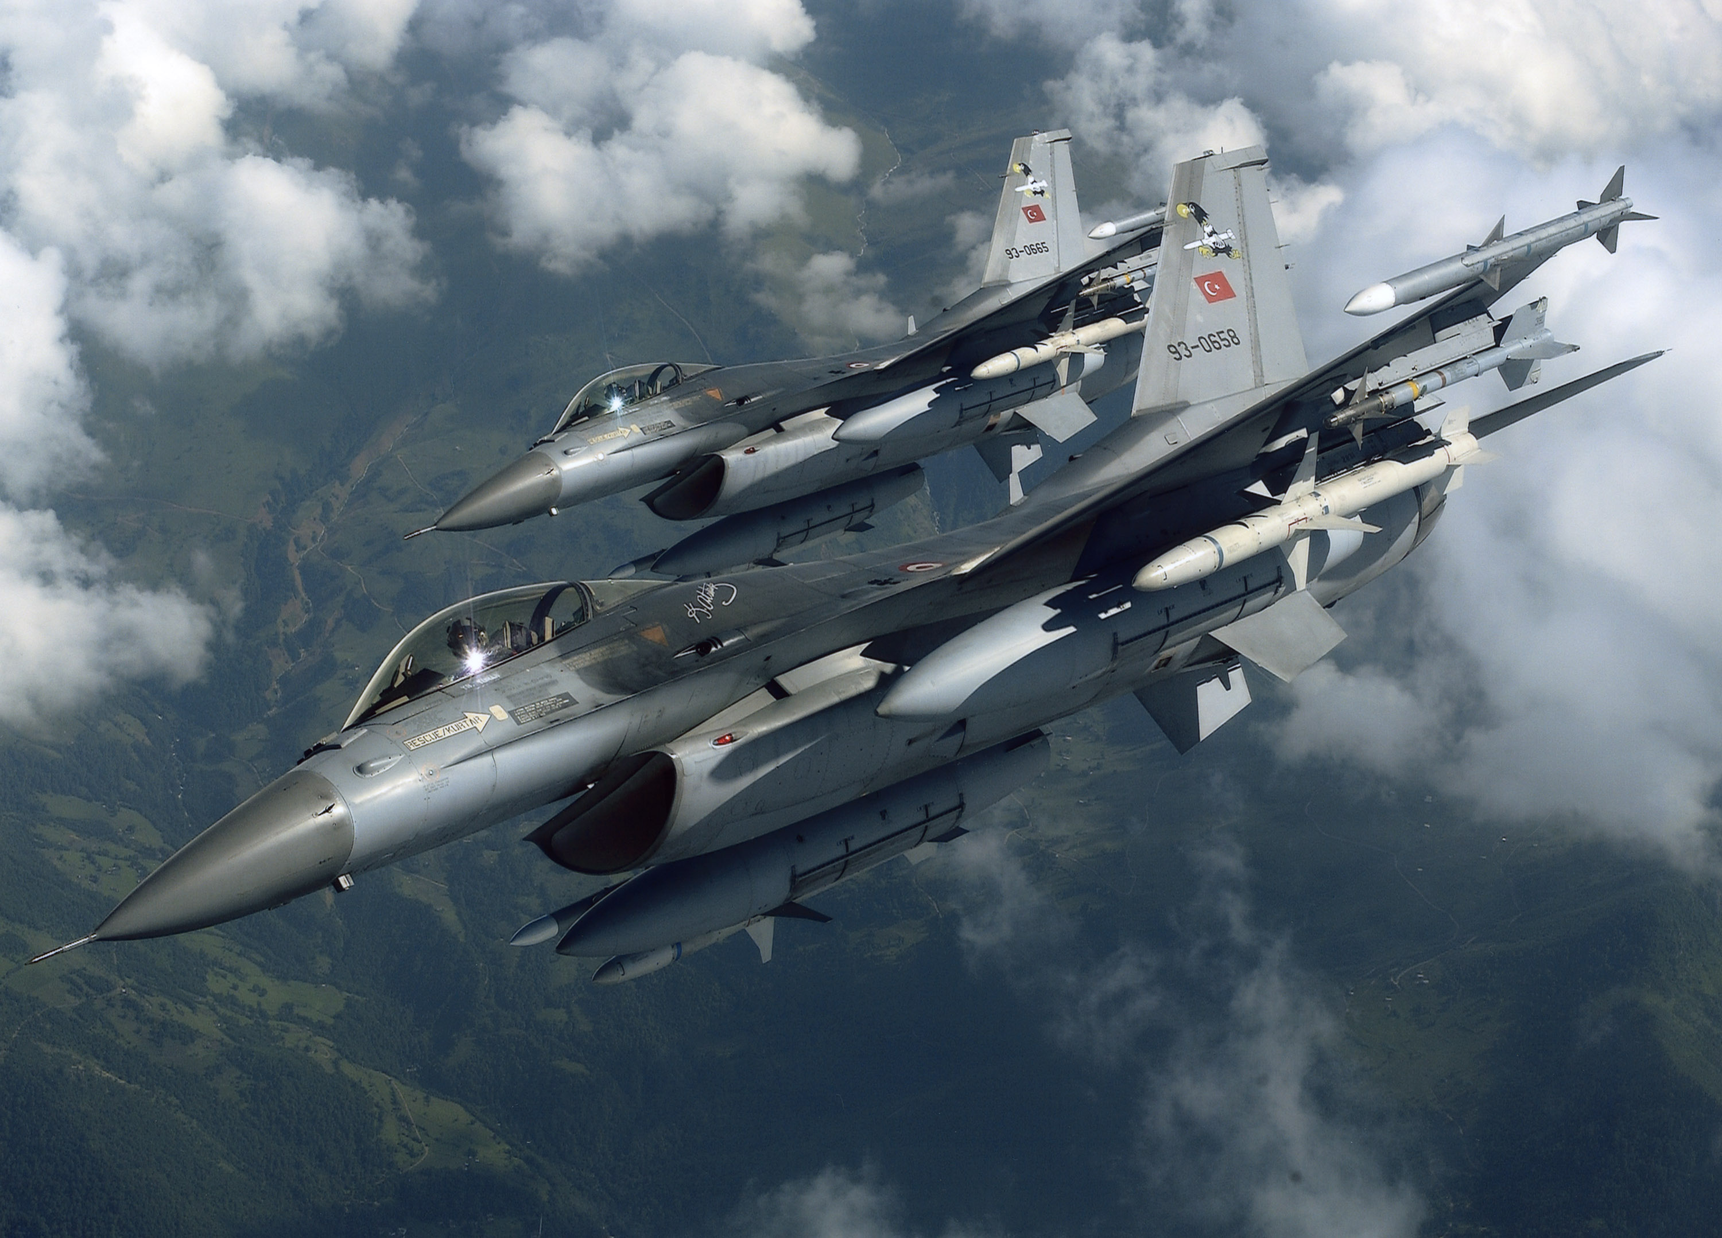

VIRTUAL REALITY FLIGHT
SIMULATOR
CPG – 38
Mentor: Dr Ajay Kumar
Project Team:
102003121 Abdul Basit Bhat
102183003 Anmol Preet Kaur
102183024 Sasmita Maharana
102003113 Ritika

Slide 2
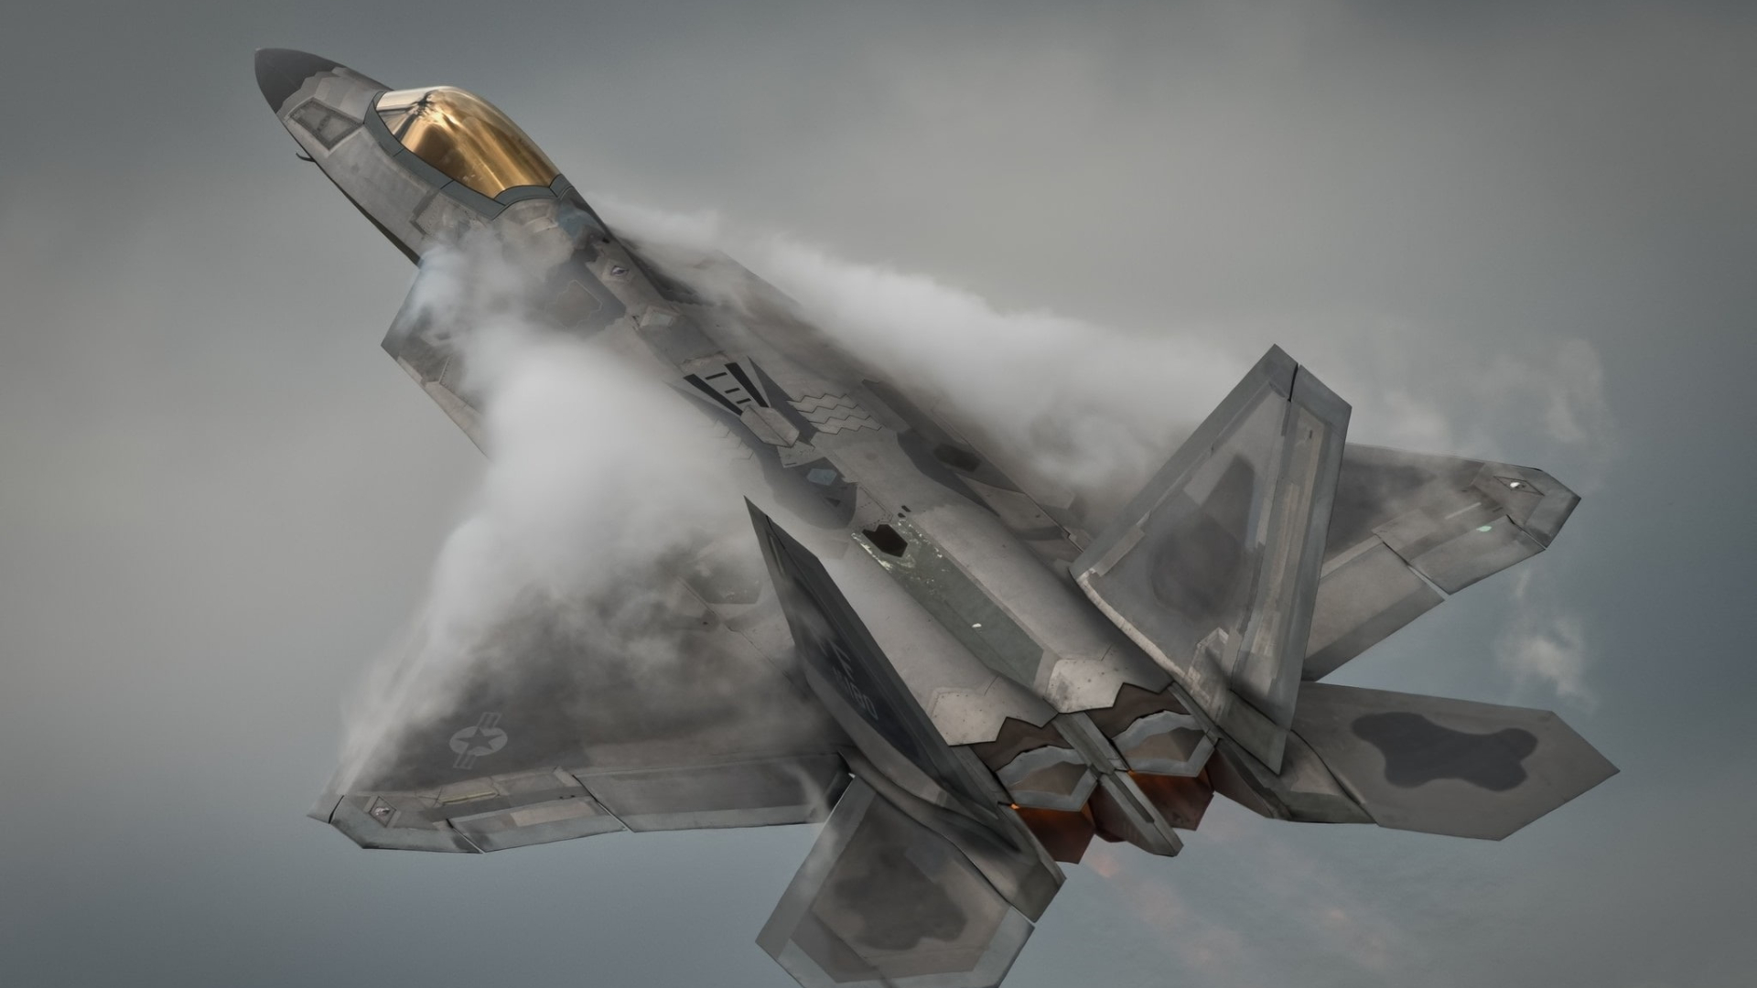
Table Of Content
Background Of Project
Scope and Utility
Objectives
Literature Survey
Architecture Of Project
Techniques and Tools Used
Snapshots
Mathematical Modelling
Graphics Modelling
Resources

Slide 3
Background
The VR flight simulator project is designed to complement rather than replace conventional training systems, serving as a valuable aid to bridge the existing training gap.
Acknowledging the importance and reliability of conventional systems, this project focuses on leveraging Virtual Reality (VR) technology to enhance the training experience. By offering a supplementary tool, it aims to address the limitations of traditional simulators, providing additional practice opportunities and a more immersive learning environment.
The goal is to create a symbiotic relationship between the VR simulator and existing systems, augmenting the training process and offering a more comprehensive learning platform for aviation schools and aviators.

Slide 4
Project Scope
Scope Overview: The project aims to build a straightforward system that allows users to control a basic plane effectively. It will include intuitive controls for managing different axis rotations. Additionally, an autopilot feature will assist in automated flight, while ensuring safe takeoff and landing processes. The system will also feature a display to present crucial flight parameters for user reference.
Plane Control: Develop controls for managing all rotation axes of the plane.
Autopilot: Implement an autopilot function for automated flight assistance.
Takeoff & Landing: Enable mechanisms for safe takeoff and landing procedures.
Parameter Display: Design a dashboard (or hood) to show various vital flight parameters.
Deliverables:
User-friendly interface for controlling plane axes.
Functional autopilot system.
Takeoff and landing mechanisms.
Dashboard/hood for displaying vital flight parameters.
Exclusions: This project will not encompass advanced flight functionalities beyond basic plane control, nor will it involve complex avionics or non-essential features.

Slide 5
Objectives
Intuitive Controls: Develop a user-friendly interface enabling precise control over all plane rotation axes, ensuring ease of operation for pilots.
Autopilot Integration: Implement a reliable autopilot system to assist in automated flight, enhancing safety and reducing pilot workload.
Dashboard for Parameter Display: Design a clear and comprehensive dashboard to display essential flight parameters, aiding pilots in monitoring crucial data during operation.
Usability Testing and Refinement: Conduct thorough user testing to gather feedback for refining the interface and functionalities, ensuring optimal user experience.
Documentation and Knowledge Transfer: Create detailed documentation to facilitate easy comprehension, maintenance, and future development of the implemented system.

Slide 6
Literature Survey
1. Dorn and Johnson[1] investigated the usability and effectiveness of a VR flight simulator for training commercial airline pilots. The authors found that the simulator was generally well- received by the pilots, and that it provided a realistic simulation of flight conditions.
2. Berg and Houten[2] evaluated the effectiveness of a VR flight simulator in training military pilots. The authors found that the simulator was effective in training pilots on basic flight skills.
3. Kennedy, Drexler, Kennedy, and Bennett [3] investigated the incidence and causes of simulator sickness in VR flight simulators. The authors found that simulator sickness was a common problem, and that it was primarily caused by conflicts between visual and vestibular sensory input.
4. DeRoche, Williams, Rupp, and Vincenzi [4] evaluated the effectiveness of a VR flight simulator for training military pilots. The authors found that the simulator improved flight safety and reduced the number of accidents.
5. Kim, Kim, Yoo, Kim, and Kim [5] reviewed 31 studies on the effectiveness of VR flight simulators for pilot training. The authors found that VR simulators were generally effective for training, and that they had several advantages over traditional training methods, including cost savings and increased safety.

Slide 7
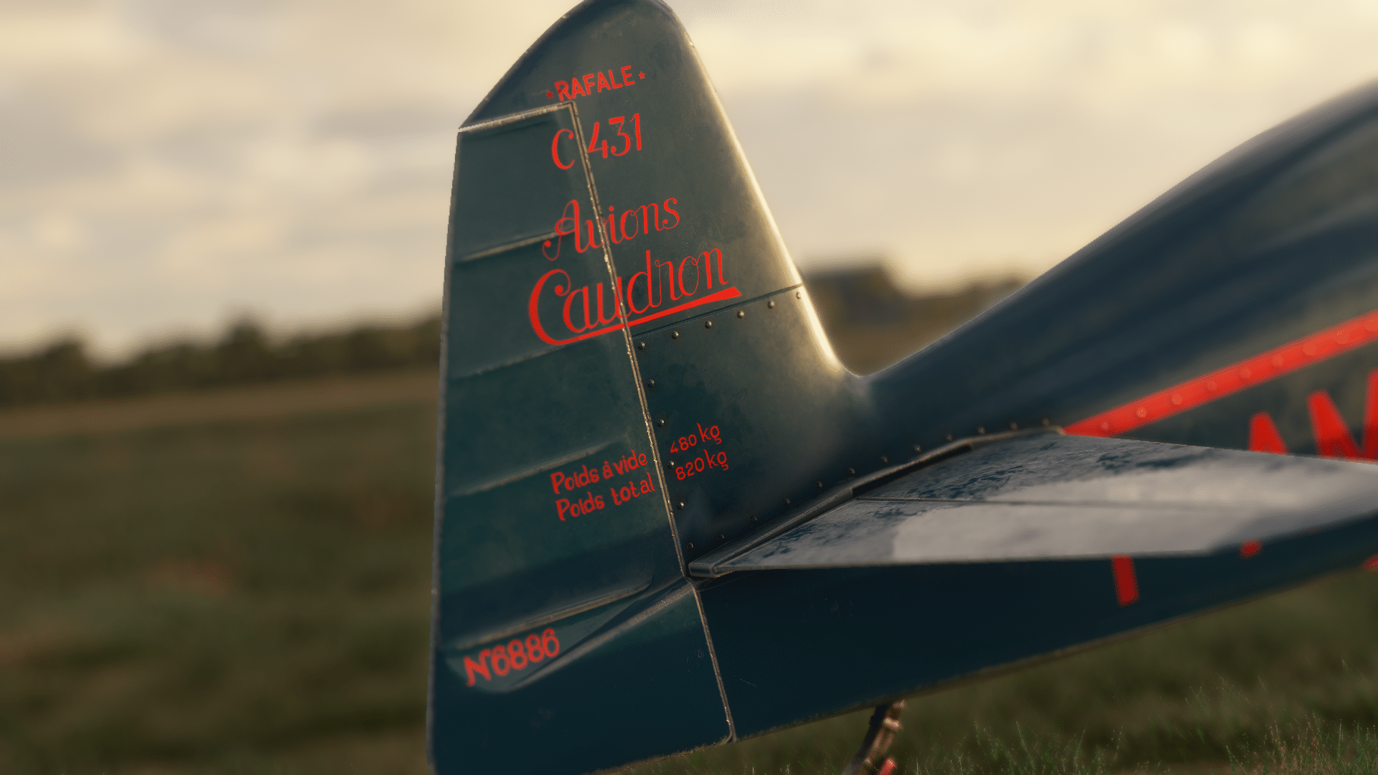
Architecture

Slide 8
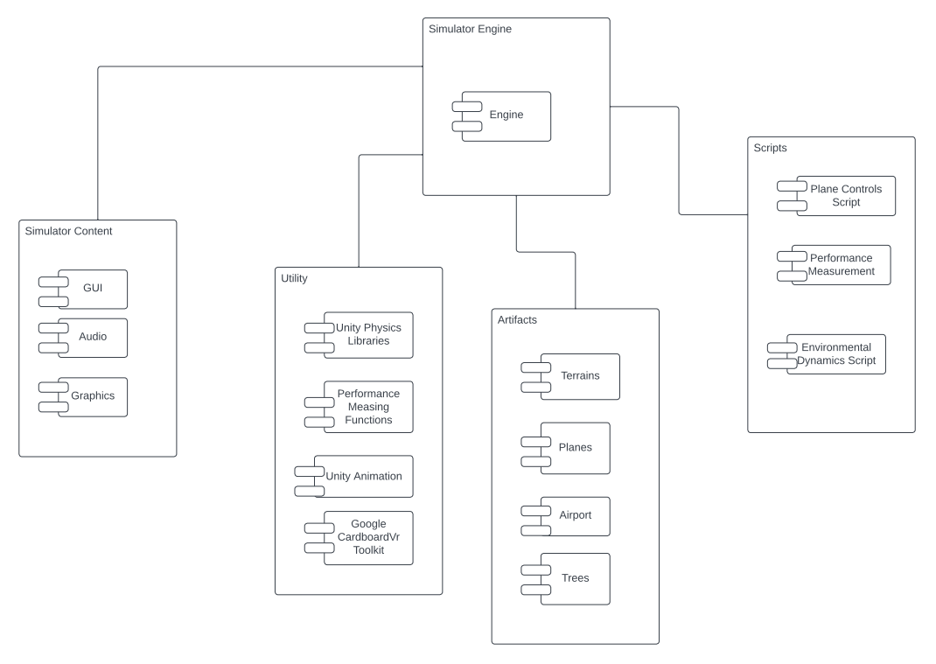
Component Diagram
Engine
Scripts
Contents
Utilities
Artifacts

Slide 9
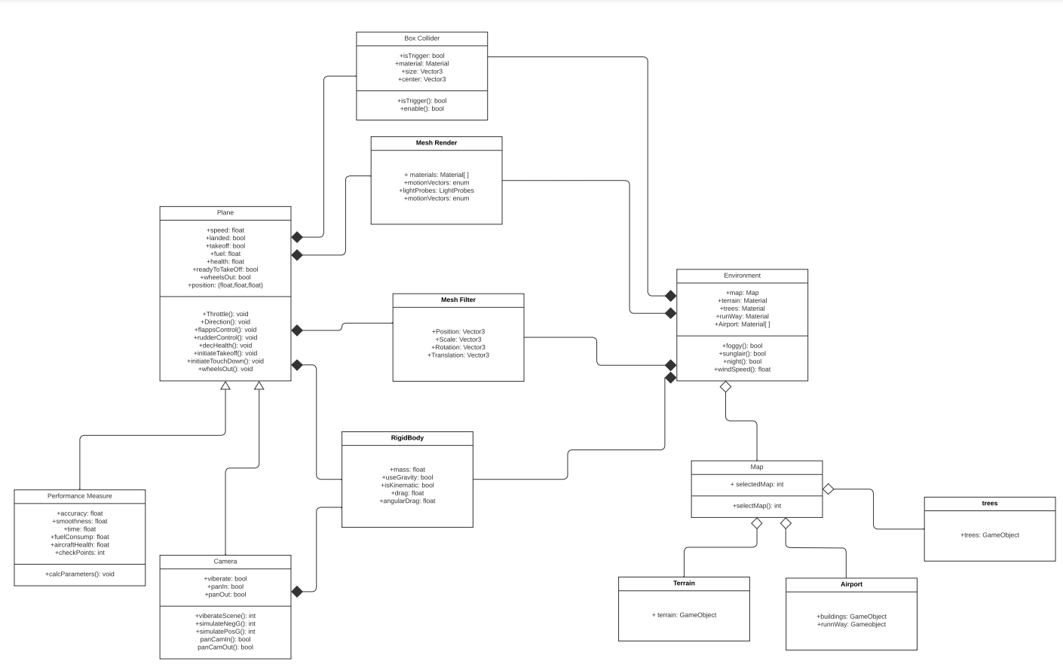
UML Diagram
Environment
Map
Terrain
Tree
Airport
Plane
Camera
Performance Measures
Rigid Body
Box Collider
Mesh Render
Mesh Filter

Slide 10
Plane Object
Parent
Child
Camera Object
Camera Controller Script
Plane Controller Script

Slide 11
Development

Slide 12
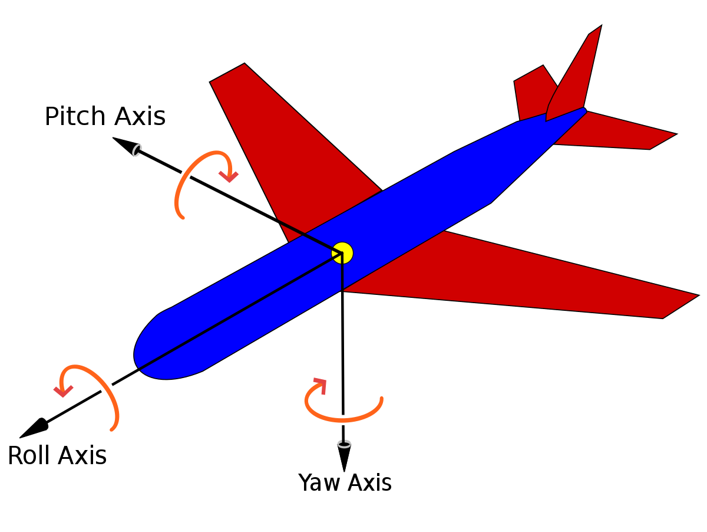
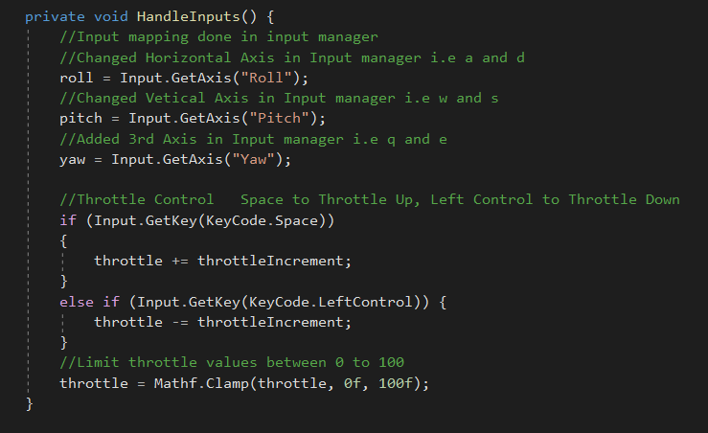
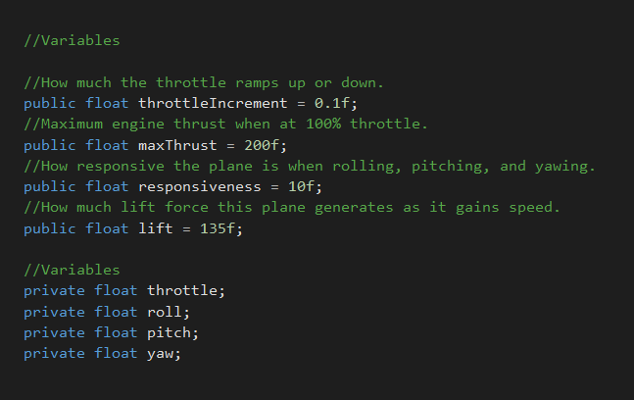
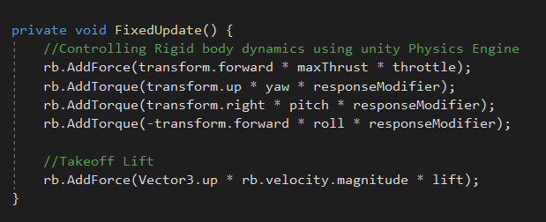
Mathematical Modelling

Slide 13




Tools and Technologies

Slide 14
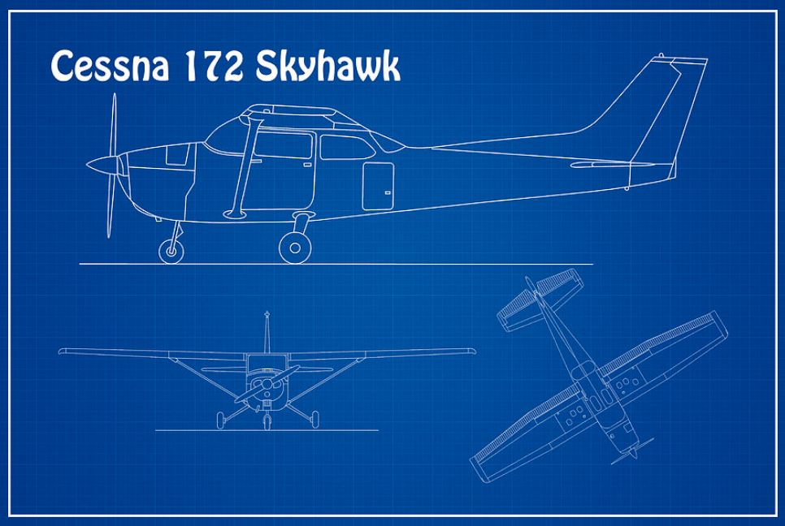

Slide 15
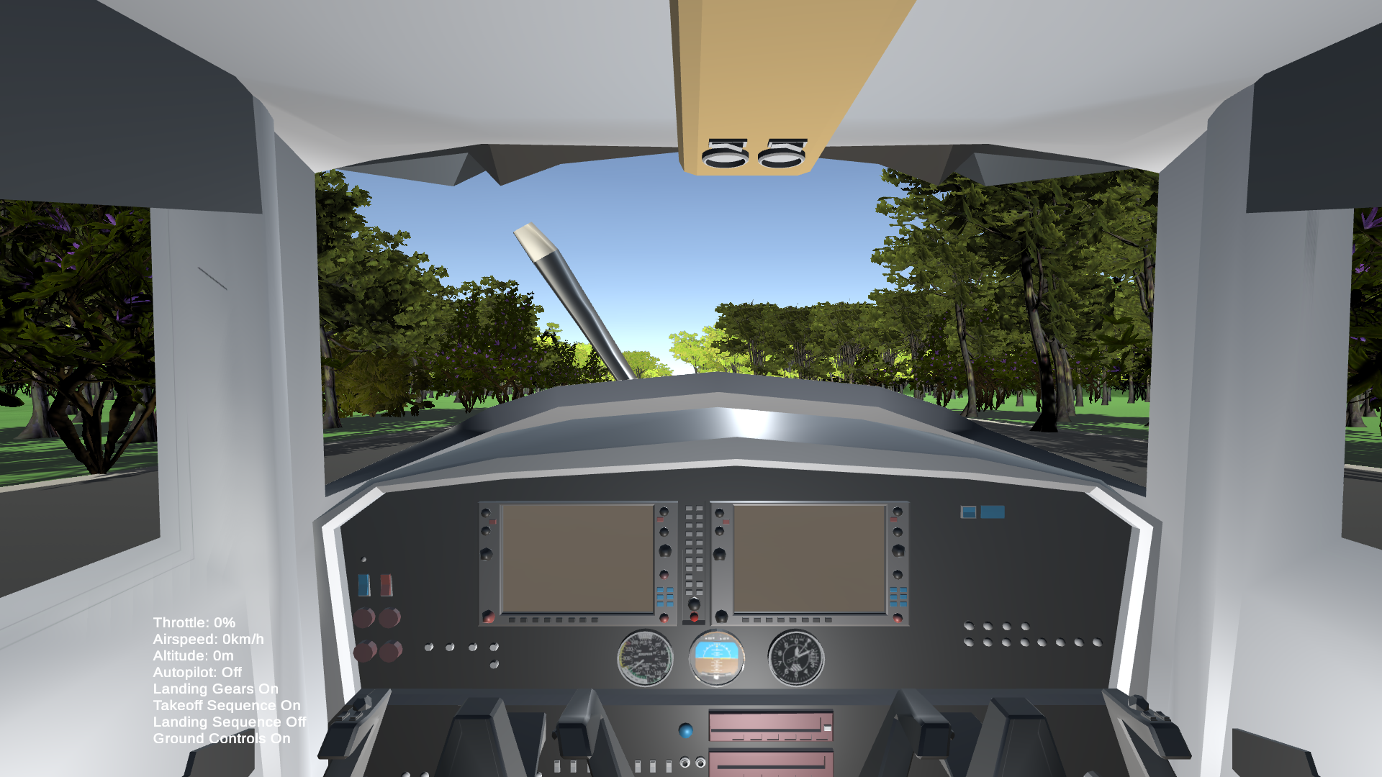
Snapshots

Slide 16
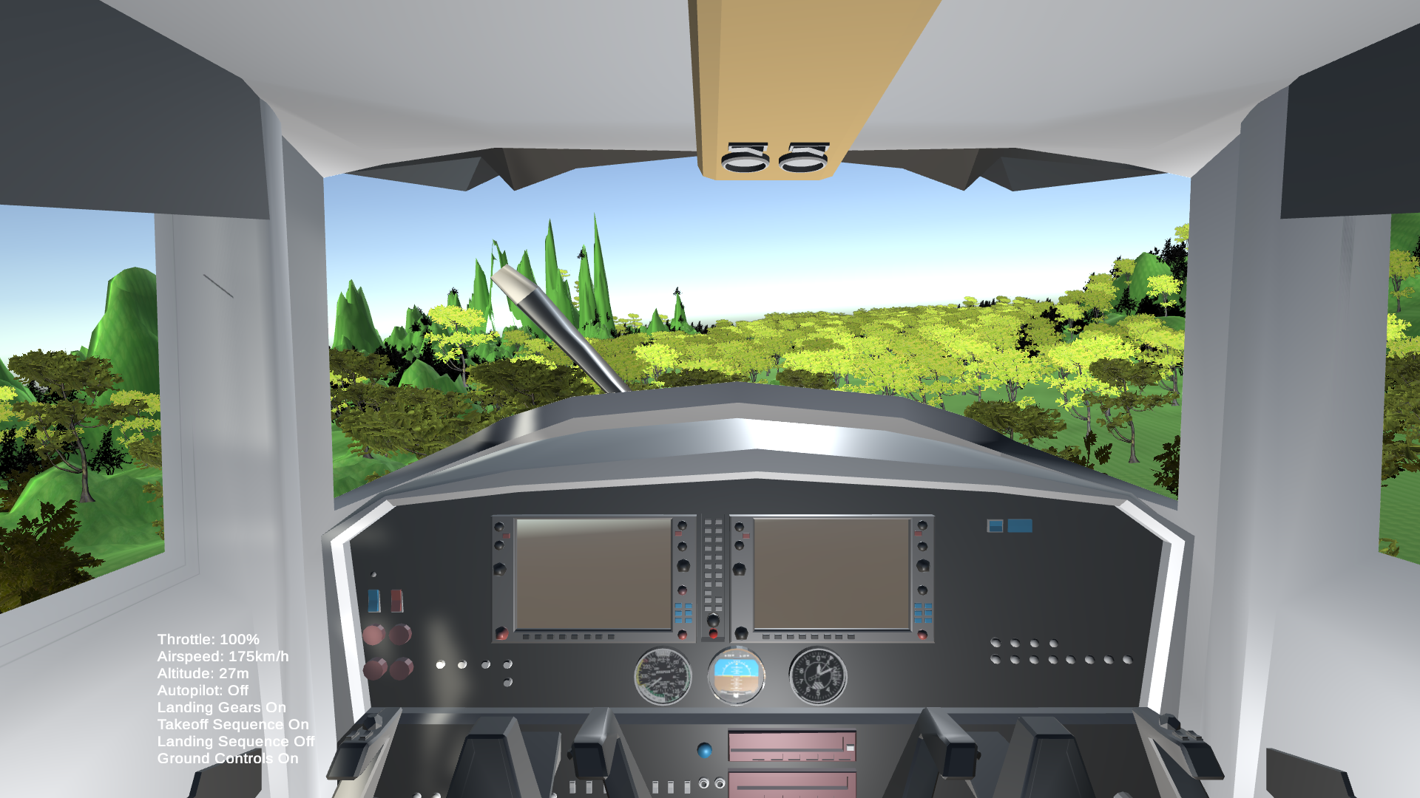

Slide 17
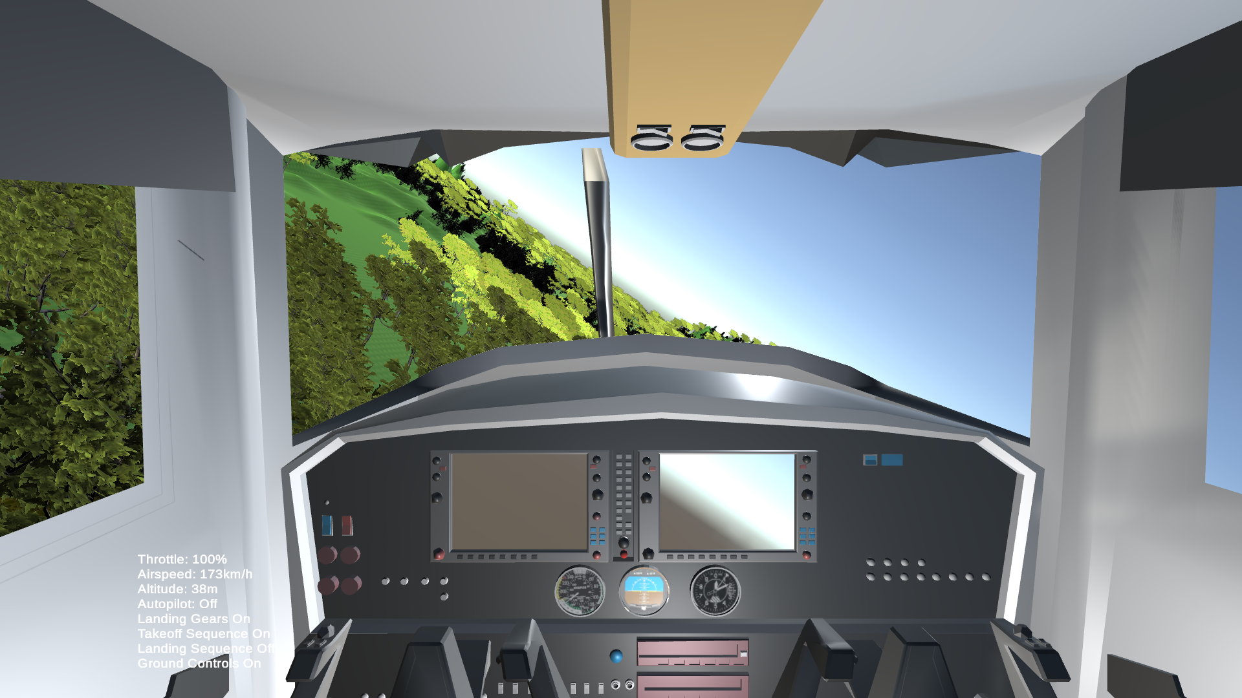

Slide 18
Conclusion

Slide 19
Professional Learnings
Project Management: Understanding how to coordinate a team of diverse skills, manage resources, and adhere to timelines within a complex project structure.
Adaptability: Navigating unforeseen challenges and adapting strategies to meet changing requirements or technological hurdles.
User-Centric Design: Learning to prioritize user experience and feedback to create a product that best suits the needs of pilots and aviation schools.

Slide 20
Technical Learnings
Virtual Reality Development: Gaining expertise in VR technology, understanding its applications, limitations, and best practices for creating immersive experiences.
Flight Dynamics: Acquiring knowledge of aerodynamics, aircraft behavior, and simulation modeling to create realistic flight experiences within the simulator.
Integration Skills: Developing the ability to integrate different software and hardware components, ensuring seamless functionality of the simulator.

Slide 21
Future Directions
VR Flight Simulator at present is at a phase of continuous improvements and will continue to get better. The Future of this project will consist of
Modelling the Dynamics of Commercial Aircrafts.
Adding Routes and maps to the simulator.
Adding Performance Measures. A real time performance related data will be calculated and displayed to the aviator. The aviator can then do the necessary steps to get an optimal score.
Integration of Cloud Computing. The data stored by the system can be pushed onto cloud for performance analytics.

Slide 22
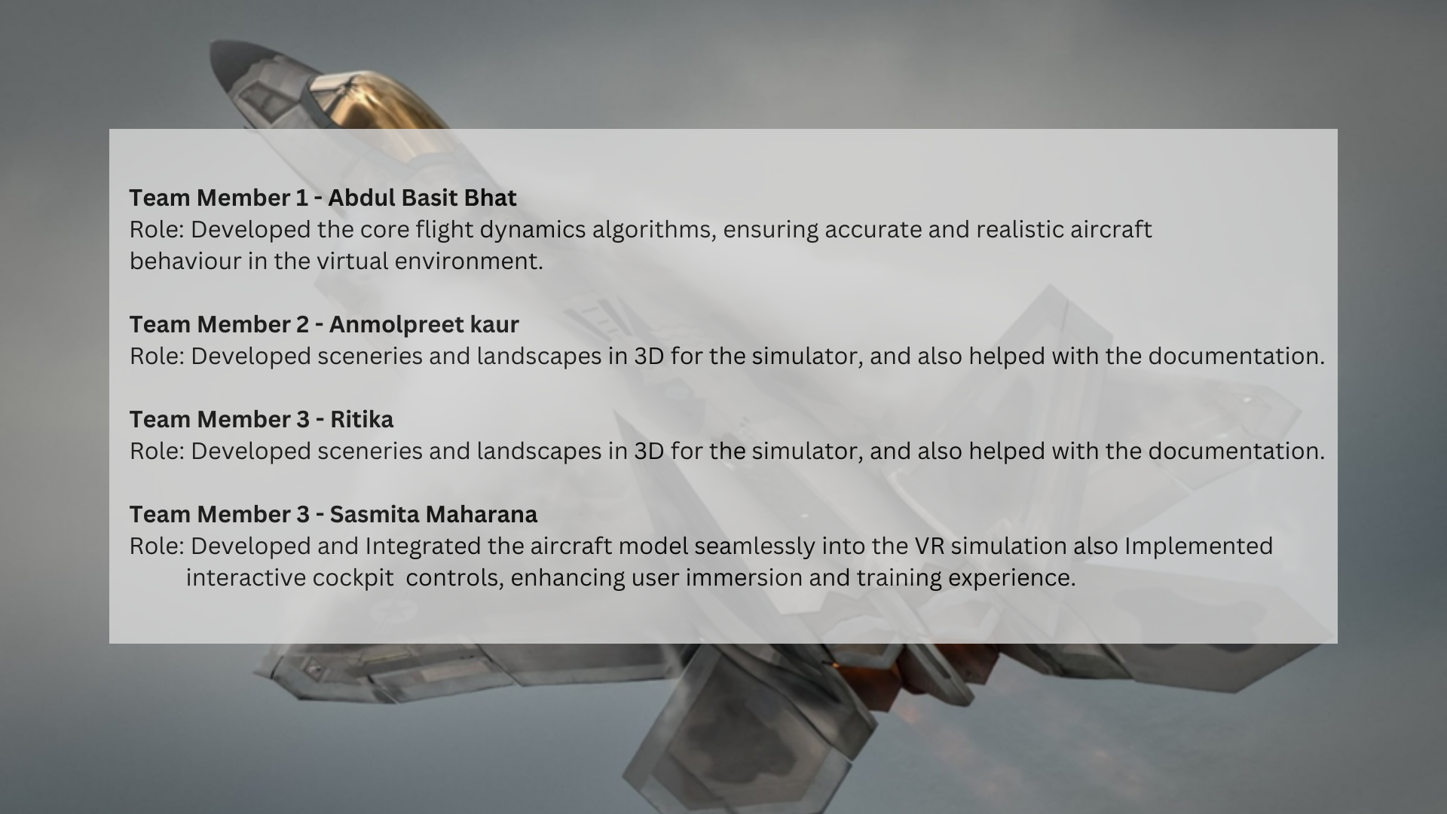

Slide 23
References
[1] Johnstone R., Morrison D. ”Virtual Reality for training in aviation.” Journal of Aviation, Space, and Environmental Medicine,77(8)
[2] Gaillard A., Guillou S., “Virtual Reality-Based Flight Simulation: A Promising Approach for Training and Education in Aviation.” The International Journal of Aviation Psychology,25(3)
[3] Wright M., Endsley M.,Kraiger K., “Assessing the Transfer of Training from Virtual to Real Flight Using Behavior-Based Metrics.” Human Factors: The Journal of the Human Factors and Ergonomics Society,61(5)
[4] Lintern K.,Matthews P.,”Virtual Reality Flight Simulation: A New Era in Flight Training?” The International Journal of Aviation Psychology,24(2)
[5] Walker A., “Enhancing Flight Simulation Training with Virtual Reality.” Aviation, Space, and Environmental Medicine,91(6)

Slide 24
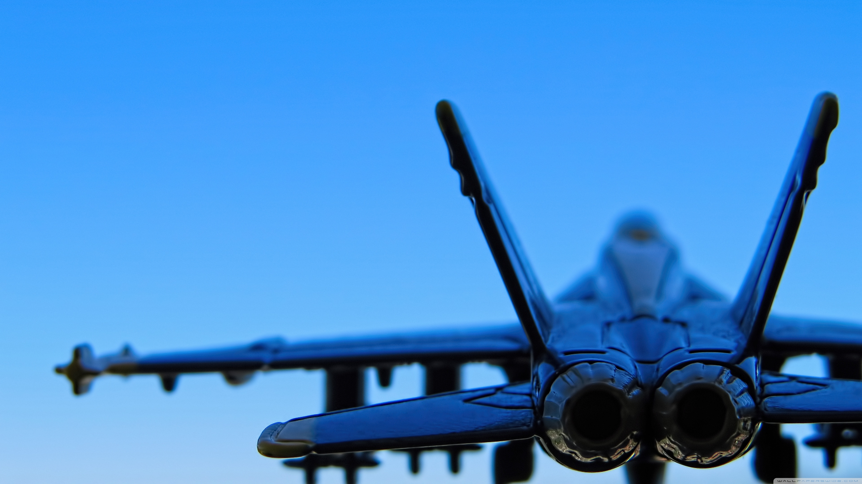
Resources
Unity Learn
https://learn.unity.com/course/beginner-scripting
Airplane Parts and Functions
https://www1.grc.nasa.gov/beginners-guide-to-aeronautics/airplane-parts-function/
Aircraft Dynamics
https://en.wikipedia.org/wiki/Aircraft_flight_dynamics
Google
https://www.google.com/
Pintrest
https://in.pinterest.com/

